Slide 1
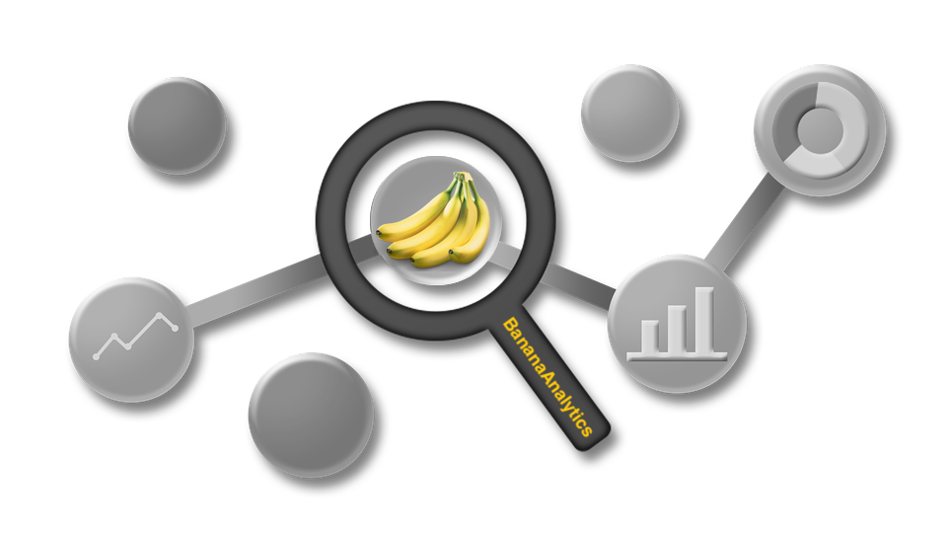
BANANA ANALYTICS
PRESENTED BY ANTON, DAVID, FELIX AND RAHEL

Slide 2




TEAM
DAVID FÜRER
PROJECT COORDINATOR
RAHEL WEHRLI
WIKI-CREATOR
ANTON LORVI
SOLUTION ENGINEER
FELIX SCHENKER
BUSINESS ANALYST
Notes:
Rahel to shortly introduce the project team and what each is going to present:
David -> coordinator and process owner is going to explain the current state
Anton -> programmer is going to introduce our solution
Felix -> Investigator and Buisness Analyst is going to describe our business

Slide 3
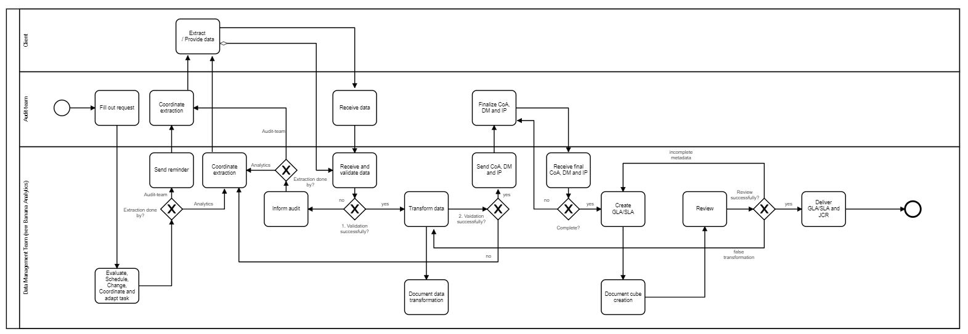
AS-IS PROCESS

Slide 4
STAKEHOLDERS
Audit team
Auditors perform (internal) financial and risk management audits and independent statutory (external) financial audits of commercial and public sector organizations. Auditors assess local and central government departments with the aim of improving efficiency and effectiveness.
Client (company to be audited)
The process audit is part of a company's QM system and should lead to capable and controlled processes that are robust against disturbance variables. The subject of the audit is the product development process/series production or a service development process/service provision.
Banana Analytics (Service provider with the analytics tool)
Banana Analytics offers the right solution for this requirement with new technology for the audit process. Banana Analytics has bundled the data preparation requirements and implemented a tool to prepare the data more efficiently for the audits.

Slide 5
AS-IS PROCESS

Slide 6
Feeling very gratifying
Feeling satisfy
Coordinate extraction
After reviewing the sent request, the data management team is confirming the order and a data extraction reminder is set, if the audit team is performing the extraction. This email-reminder includes all necessary information and files. If the data management team is handling the data extraction, the client is contacted directly with the necessary information.
Feeling ok
Fill out request
The audit team fills out the requrest (excel sheet). This excel is sent to the data management team. If changes occure, the excel is adapted and sent again. This leads to multiple sheets and no single point of truth.
Receive data
Either the audit team or client is uploading the extracted data with a transfer-solution. After receipt, the data is quickly checked for completeness and validity.
Feeling bad
Finalize CoA, DM and IP
After data transformation, the information is loaded into the analytics tool. In order to finalize the parameters, the audit team needs to complete the chart of accounts, the period identification, and dimension tables. Therefore, the information is sent to the audit team. There is no centralized storage for all information, making collaboration difficult, especially with data management team members.
Feeling horrible
General Problems
There is no single point of truth for any information (request, chart of account, dimension tables, audit communications)
There is no central storage to access other team members information in case of absence or support.
There is no overview about who is doing which engagement and what the current status is.
There are no automated emails of reoccurring communications.
There is no automated solution to query for status information.

Slide 7


EXPERIENCE
Fill out request
The audit team fills out the request (excel-sheet). This excel is sent to the data management team. If changes occure, the excel is adapted and sent again. This leads to multiple sheets and no single point of truth.
Coordinate extraction
After reviewing the sent request, the data management team is confirming the order and a data extraction reminder is set, if the audit team is performing the extraction. This email-reminder includes all necessary information and files. If the data management team is handling the data extraction, the client is contacted directly with the necessary information.
Receive data
Either the audit team or client is uploading the extracted data with a transfer-solution. After receipt, the data is quickly checked for completeness and validity.

Slide 8


EXPERIENCE
General Problem
There is no single point of truth for any information (request, chart of account, dimension tables, audit communications)
There is no central storage to access other team members information in case of absence or support.
There is no overview about who is doing which engagement and what the current status is.
There are no automated emails of reoccurring communications.
There is no automated solution to query for status information.
Finalize CoA, DM and IP
After data transformation, the information is loaded into the analytics tool. In order to finalize the parameters, the audit team needs to complete the chart of accounts, the period identification, and dimension tables. Therefore, the information is sent to the audit team. There is no centralized storage for all information, making collaboration difficult, especially with data management team members.

Slide 9
IMPROVE & SPIN-OFF
The digitization of business processes, also in the audit business area, brings with it many new challenges and opportunities. The current audit approach and audit processing, e.g. through the use of standard structures, document checks and invoice-specific requirements, are very work-intensive and almost inefficient. In order to achieve the necessary complex regulations both from the point of view of the audit team and for the company to be audited, new support technologies are necessary for an efficient audit process.
To meet the necessary regular requirements, Banana Analytics offers the right solution for this requirement with new technology for the audit process. Banana Analytics has bundled the data preparation requirements and implemented a tool to prepare the data more efficiently for the audits.
Banana Analytics' simple and useful solution controls all the steps through the data analysis process. As a result, most of the manual steps can be automated. The solution allows the use of a mobile analysis solution or the installation directly on the client, without data loss.

Slide 10
LIVE DEMO

Slide 11
QUESTIONS

Slide 12
THANK YOU

